Slide 1
IEC ACTIVITYON PLASTIC WASTE MANAGEMENT AWARENESS-PROGRAM Collaboration with UNDP and HCCB Pvt. Ltd.

Slide 2
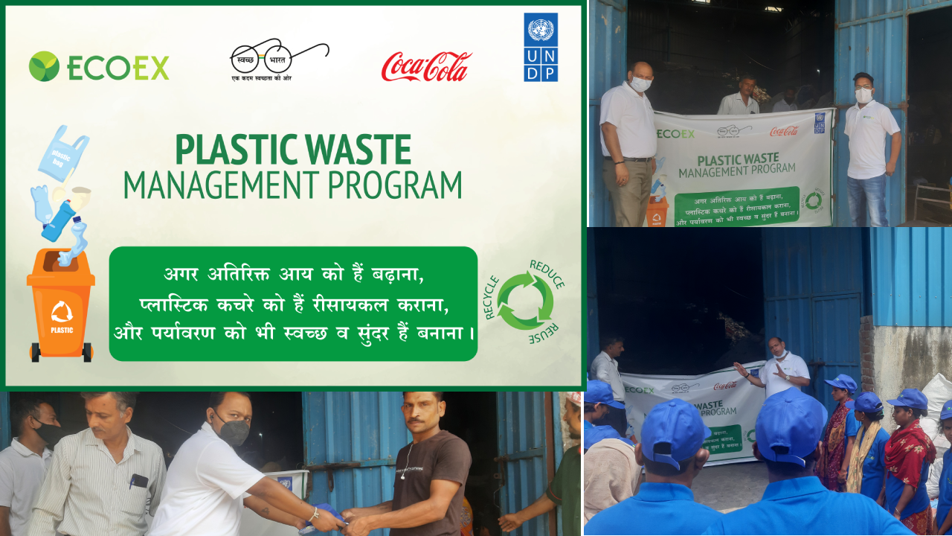
IEC Activity Location -1 Morta Industrial Area, Ghaziabad. Number of Attendees – 16 Persons

Slide 3
T-shirts and caps were distributed to the rag pickers.
We educated them on the importance of separating different sorts of plastics.
They were made aware of the many health risks they can encounter while collecting plastic from dumps or junkyards.
We advised them to use PPE such as masks, gloves, eyeglasses, and gumboots.
Make them aware of how effective plastic segregation can help them earn more money.
Distributed Tiffin packets to attendees/rag pickers.

Slide 4
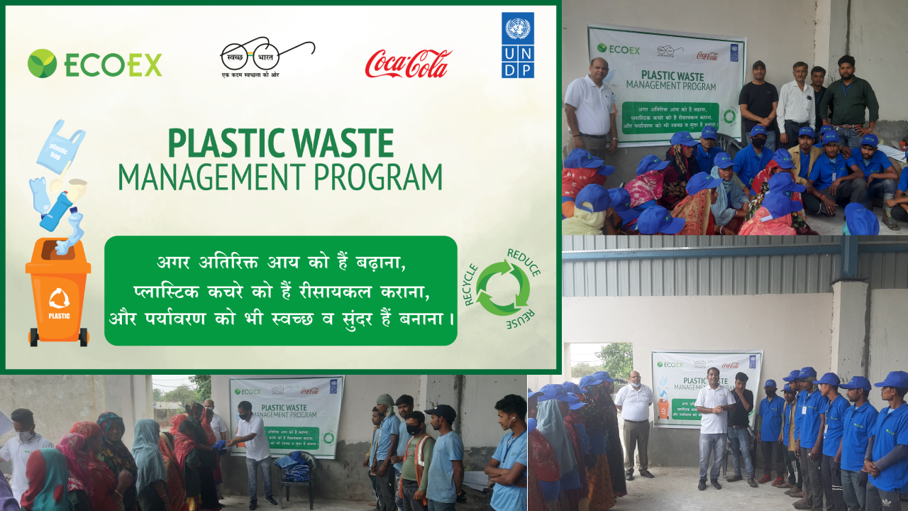
IEC Activity Location - 2 Near DPS School, Sihani,Ghaziabad Number of Attendees–30 Persons

Slide 5
T-shirts and caps were distributed to the rag pickers.
We educated them on the importance of separating different sorts of plastics.
They were made aware of the many health risks they can encounter while collecting plastic from dumps or junkyards.
We advised them to use PPE such as masks, gloves, eyeglasses, and gumboots.
Make them aware of how effective plastic segregation can help them earn more money.
Distributed tiffin packets to attendees/rag pickers.

Slide 6
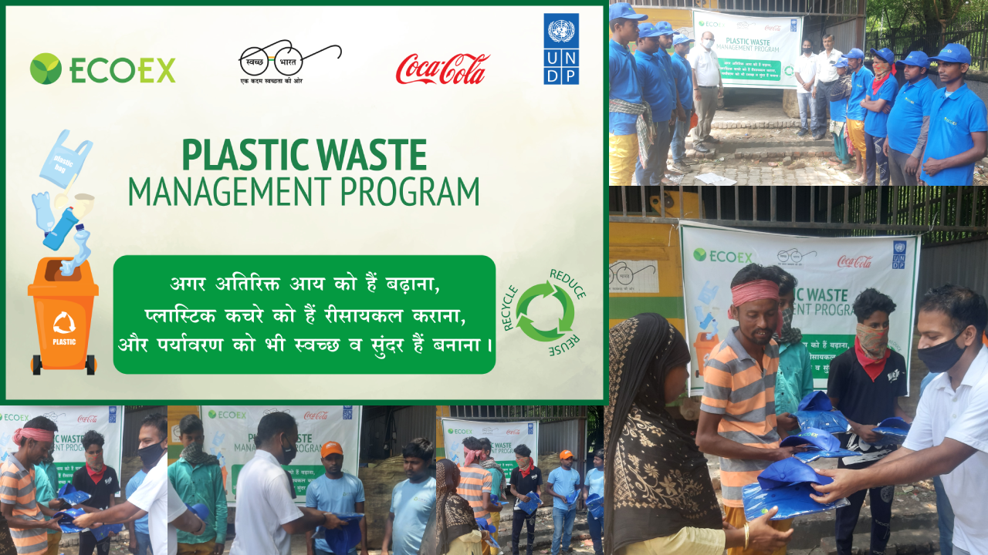
IEC Activity Location - 3 Sector – 23, Sanjay Nagar, Ghaziabad Number of Attendees – 12 Persons

Slide 7
T-shirts and caps were distributed to the rag pickers.
We educated them on the importance of separating different sorts of plastics.
They were made aware of the many health risks they can encounter while collecting plastic from dumps or junkyards.
We advised them to use PPE such as masks, gloves, eyeglasses, and gumboots.
Make them aware of how effective plastic segregation can help them earn more money.
Distributed tiffin packets to attendees/rag pickers.

Slide 8
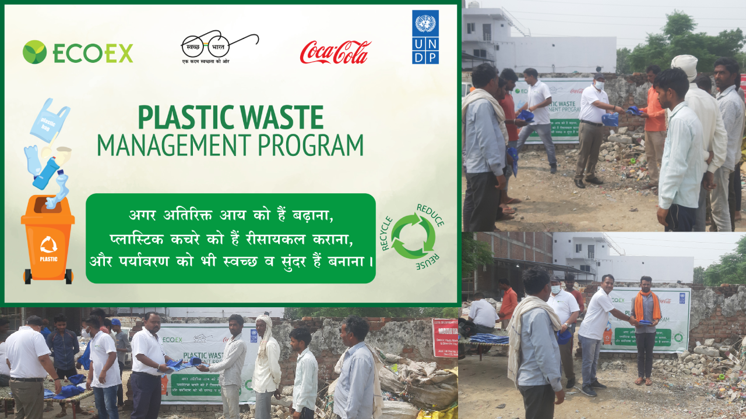
IEC Activity Location - 4 Shri Vaishno Pet,Sector 130, Noida Number of Attendees – 23 Persons

Slide 9
T-shirts and caps were distributed to the rag pickers.
We educated them on the importance of separating different sorts of plastics.
They were made aware of the many health risks they can encounter while collecting plastic from dumps or junkyards.
We advised them to use PPE such as masks, gloves, eyeglasses, and gumboots.
Make them aware of how effective plastic segregation can help them earn more money.
Distributed tiffin packets to attendees/rag pickers.

Slide 10
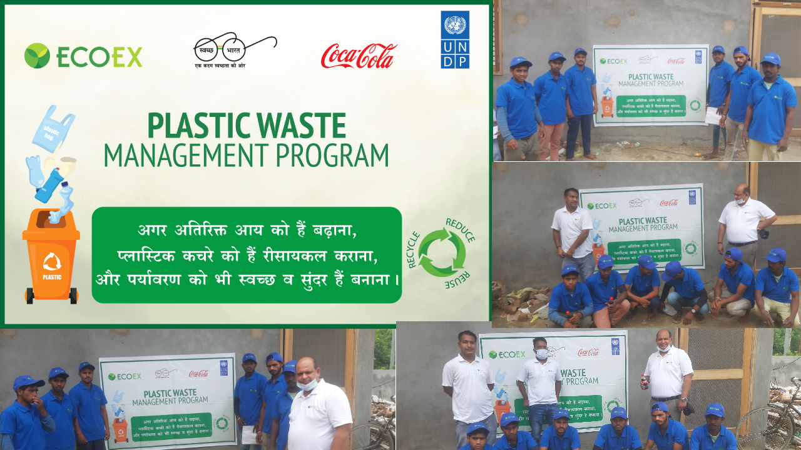
IEC Activity Location - 5 Sector 135, Noida Number of Attendees – 12 Persons

Slide 11
T-shirts and caps were distributed to the rag pickers.
We educated them on the importance of separating different sorts of plastics.
They were made aware of the many health risks they can encounter while collecting plastic from dumps or junkyards.
We advised them to use PPE such as masks, gloves, eyeglasses, and gumboots.
Make them aware of how effective plastic segregation can help them earn more money.
Distributed tiffin packets to attendees/rag pickers.

Slide 12
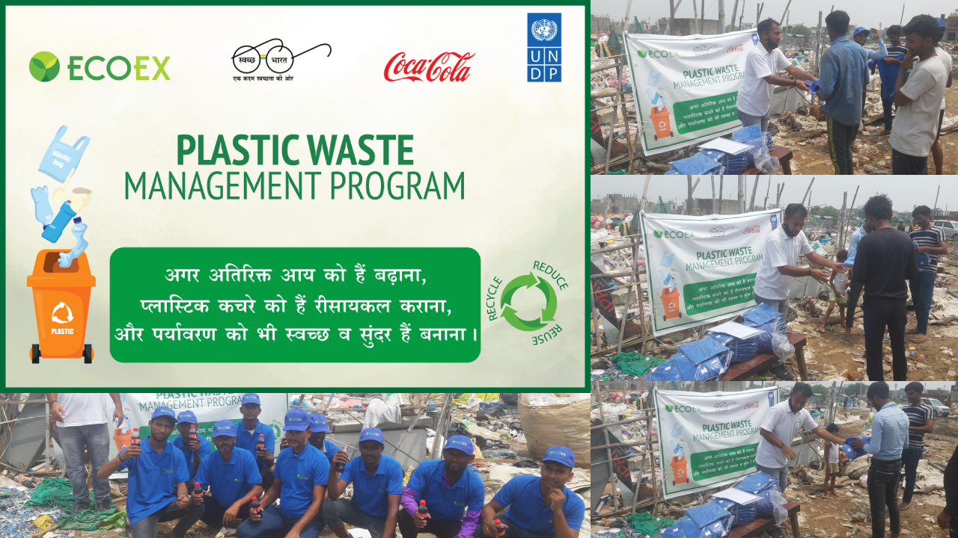
IEC Activity Location - 6 Halduani Area, Greater Noida Number of Attendees – 11 Persons

Slide 13
T-shirts and caps were distributed to the rag pickers.
We educated them on the importance of separating different sorts of plastics.
They were made aware of the many health risks they can encounter while collecting plastic from dumps or junkyards.
We advised them to use PPE such as masks, gloves, eyeglasses, and gumboots.
Make them aware of how effective plastic segregation can help them earn more money.
Distributed tiffin packets to attendees/rag pickers.

Slide 14

IEC Activity Location - 7 Habirpur Area, Greater Noida Number of Attendees – 12 Persons

Slide 15
T-shirts and caps were distributed to the rag pickers.
We educated them on the importance of separating different sorts of plastics.
They were made aware of the many health risks they can encounter while collecting plastic from dumps or junkyards.
We advised them to use PPE such as masks, gloves, eyeglasses, and gumboots.
Make them aware of how effective plastic segregation can help them earn more money.
Distributed tiffin packets to attendees/rag pickers.

Slide 16

IEC Activity Location - 8 Near KK Foods, Jalpura, Greater Noida Number of Attendees – 11 Persons

Slide 17
T-shirts and caps were distributed to the rag pickers.
We educated them on the importance of separating different sorts of plastics.
They were made aware of the many health risks they can encounter while collecting plastic from dumps or junkyards.
We advised them to use PPE such as masks, gloves, eyeglasses, and gumboots.
Make them aware of how effective plastic segregation can help them earn more money.
Distributed tiffin packets to attendees/rag pickers.

Slide 18

IEC Activity Location - 9 Jalpura Area, Greater Noida Number of Attendees – 18 Persons

Slide 19
T-shirts and caps were distributed to the rag pickers.
We educated them on the importance of separating different sorts of plastics.
They were made aware of the many health risks they can encounter while collecting plastic from dumps or junkyards.
We advised them to use PPE such as masks, gloves, eyeglasses, and gumboots.
Make them aware of how effective plastic segregation can help them earn more money.
Distributed tiffin packets to attendees/rag pickers.

Slide 20
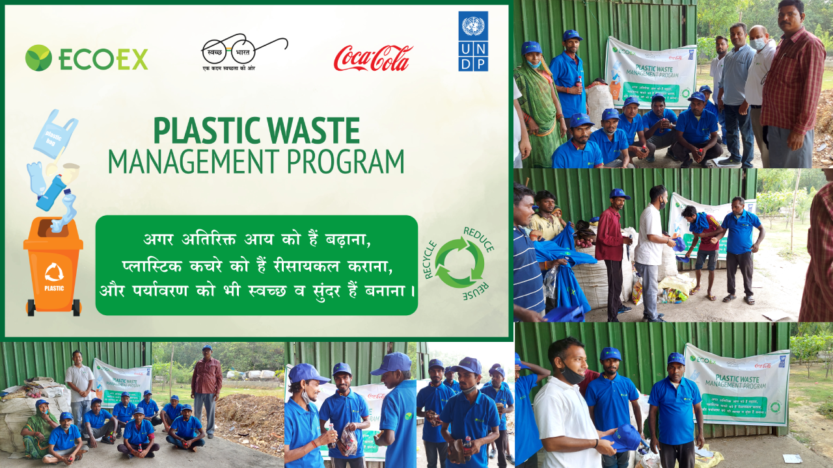
IEC Activity Location - 10 RWA SEC - 47, Noida Number of Attendees – 11 Persons

Slide 21
T-shirts and caps were distributed to the rag pickers.
We educated them on the importance of separating different sorts of plastics.
They were made aware of the many health risks they can encounter while collecting plastic from dumps or junkyards.
We advised them to use PPE such as masks, gloves, eyeglasses, and gumboots.
Make them aware of how effective plastic segregation can help them earn more money.
Distributed tiffin packets to attendees/rag pickers.

